Slide 1
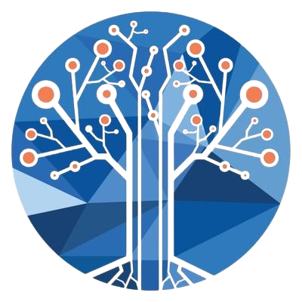
CLUSTER VISION
Student Name: Shylendhar M
Register Number: 2117240070306
Faculty In-charge: Ms. Fouzia Sulthana K
Subject: Machine Learning
Subject Code: AL23421

Slide 2
Introduction
In today’s digital world, businesses generate large volumes of customer data, but extracting meaningful insights from it remains a challenge. Cluster Vision is designed to bridge this gap by applying machine learning techniques to analyze and segment customers effectively.
The project integrates data processing, clustering algorithms, and an interactive web interface to provide clear visual insights.
It enables businesses to understand customer behavior without requiring technical expertise. Ultimately, it supports data-driven decision-making and improves marketing strategies.

Slide 3
Problem Statement
Businesses collect large amounts of customer data but struggle to extract meaningful insights from it. Without proper segmentation, they rely on generic marketing strategies that fail to address diverse customer needs.
This leads to poor customer engagement, inefficient resource use, and missed revenue opportunities.

Slide 4
GOAL
The goal of this project is to develop an automated customer segmentation system using machine learning techniques.
It applies K-Means clustering along with Silhouette Score to identify the optimal number of customer groups.
The system aims to analyze customer data and classify them based on income and spending behavior.
It provides an interactive dashboard to visualize the clusters in a simple and understandable way. Ultimately, it helps businesses make data-driven decisions without requiring technical expertise.

Slide 5
KEY CONCEPTS
Customer segmentation is the process of dividing customers into groups based on similar characteristics to better understand their behavior.
K-Means clustering is an unsupervised machine learning algorithm that groups data into clusters by minimizing the distance between data points and their cluster centers.
The Silhouette Score is used to evaluate clustering quality and determine the optimal number of clusters.
Together, these concepts enable effective analysis and meaningful grouping of customer data.

Slide 6
DATASET AND FEATURES
Dataset & Features
Dataset:
Mall_Customers.csv
Samples: ~200 customers
Features Used:
Annual Income
Spending Score
Output: Cluster labels (5 groups)

Slide 7

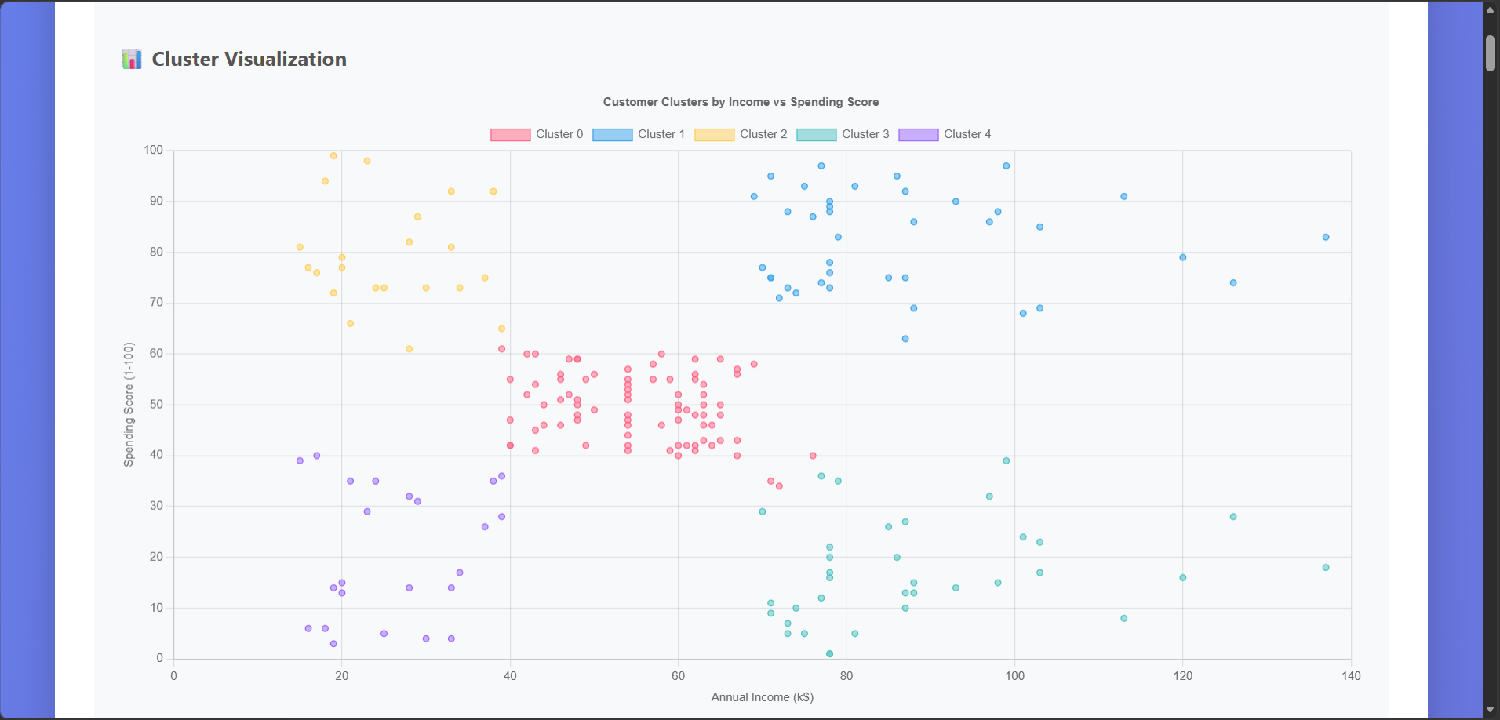

Slide 8
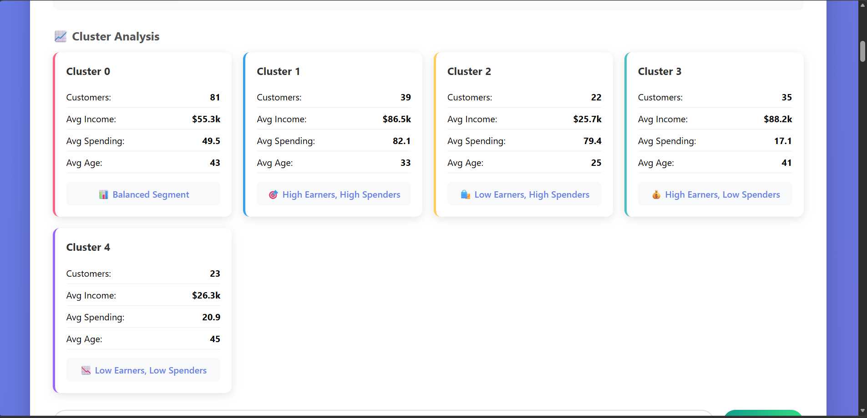

Slide 9
RESULT
Optimal clusters found: K = 5
Customer segments:
High Income, High Spending → Target customers
Low Income, High Spending → Impulsive buyers
High Income, Low Spending → Savers
Low Income, Low Spending → Budget customers
Average → Standard customers
👆 Figma Design

Slide 10
CONCLUSION AND FEATURE WORK
Successfully automated customer segmentation
Clear visualization of customer groups
Applications:
Targeted marketing
Personalized offers
Future Enhancements:
Add more features (age, location)
Use advanced ML models
Deploy as a scalable web app

Slide 11
References
Scikit-Learn Documentation: Comprehensive guide on the KMeans algorithm and silhouette_score metric implementation.
Pandas Documentation: Official resource for data manipulation, CSV handling, and JSON serialization using Python.
Kaggle Datasets: Source for the "Mall Customers" CSV, providing the demographic and behavioral data used for training.
UCI Machine Learning Repository: Standard academic reference for clustering datasets and benchmarking unsupervised learning models.
StatQuest with Josh Starmer: Technical video resource explaining the mathematical intuition behind K-Means and the WCSS objective function.

